Slide 1
Rockbuster Stealth - Vision 2020
22/7/2025 - Jason Roche

Slide 2
Agenda
01
Company introduction
Slide 3
02
Objectives + Data and Methods used
Slide 4-5
03
Questions posed by the business
Slide 6
04
Analysis and Insights
Slide 7- 11
05
Conclusion and Recommendations
Slide 00
Confidential

Slide 3
Company introduction
Previously a major player in physical movie rentals, Rockbuster Stealth LLC is now reimagining its role in the digital age.
By transforming its rich archive of licensed films into a modern streaming offering, the company aims to reclaim relevance in a fiercely competitive market.
Confidential

Slide 4
Our objectives
Objective 1
Objective 2
Objective 3
Identify which movies drive the highest and lowest revenue, and analyze the average rental duration to gauge customer viewing behavior.
Pinpoint where Rockbuster’s customers are located, with a focus on regions housing those with high lifetime value.
Explore how sales figures vary across geographic regions to uncover market opportunities or disparities.
Confidential

Slide 5
Data and method used
Data
Method used
Data derived from Rockbuster’s dataset which included information about their customers, payment history, individual stores, inventory and other information.
My primary tool was SQL used for performing various kinds of query-based analyses.
Confidential

Slide 6
Questions posed by the business
Rental duration + rate
Customer bases
Revenue
How long does the average rental last?
What is the average rate charged per rental?
Can we identify the top 10 countries of operation?
Can we see the top 10 cities that fall within the top 10 countries?
Where do the top 5 paying customers come from?
Can we establish which movie rating has the highest revenue generated?
Confidential

Slide 7
Analysis and Insights
Rental Duration
Rental Rate
Rental Length
Replacement Cost
AVERAGE
5 days
$2.98
115 minutes
$19.98
MINIMUM
3 days
$0.99
46 minutes
$9.99
MAXIMUM
7 days
$4.99
185 minutes
$29.99
Rockbuster’s library currently includes a count of 1000 titles available. From the table above, we can answer the following questions;
How long does the average rental last? - 5 days
What is the average rate charged per rental? - $2.98
On top of this, we have learned the average length of a rental is 115 minutes and the average cost of a replacement is $19.98.
Confidential

Slide 8
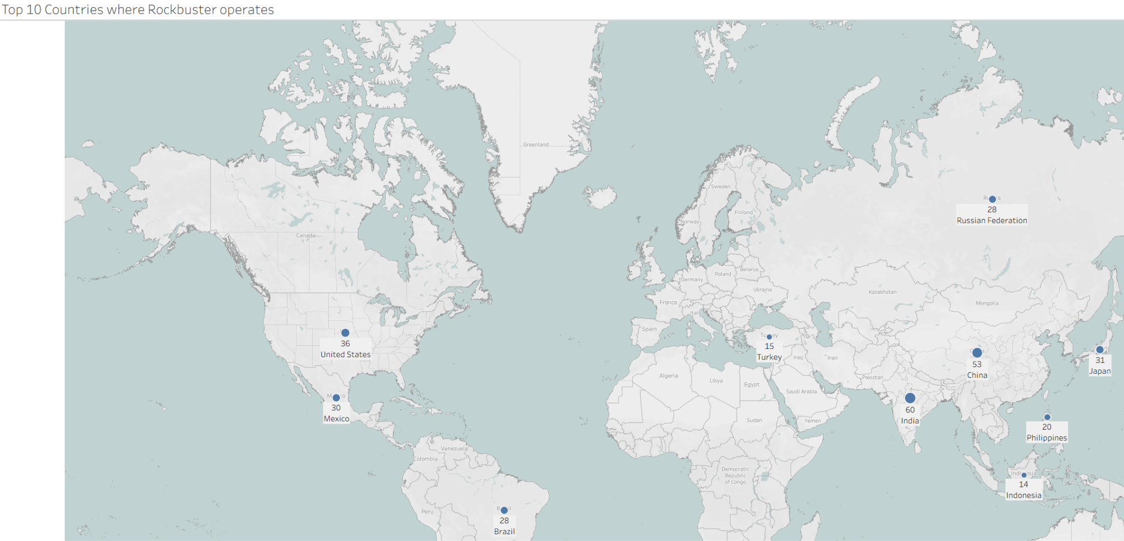
Analysis and Insights
This map visualises the top 10 countries where Rockbuster operates. We see both established markets like India and China, as well as growing markets like Brazil and Mexico.
Confidential

Slide 9
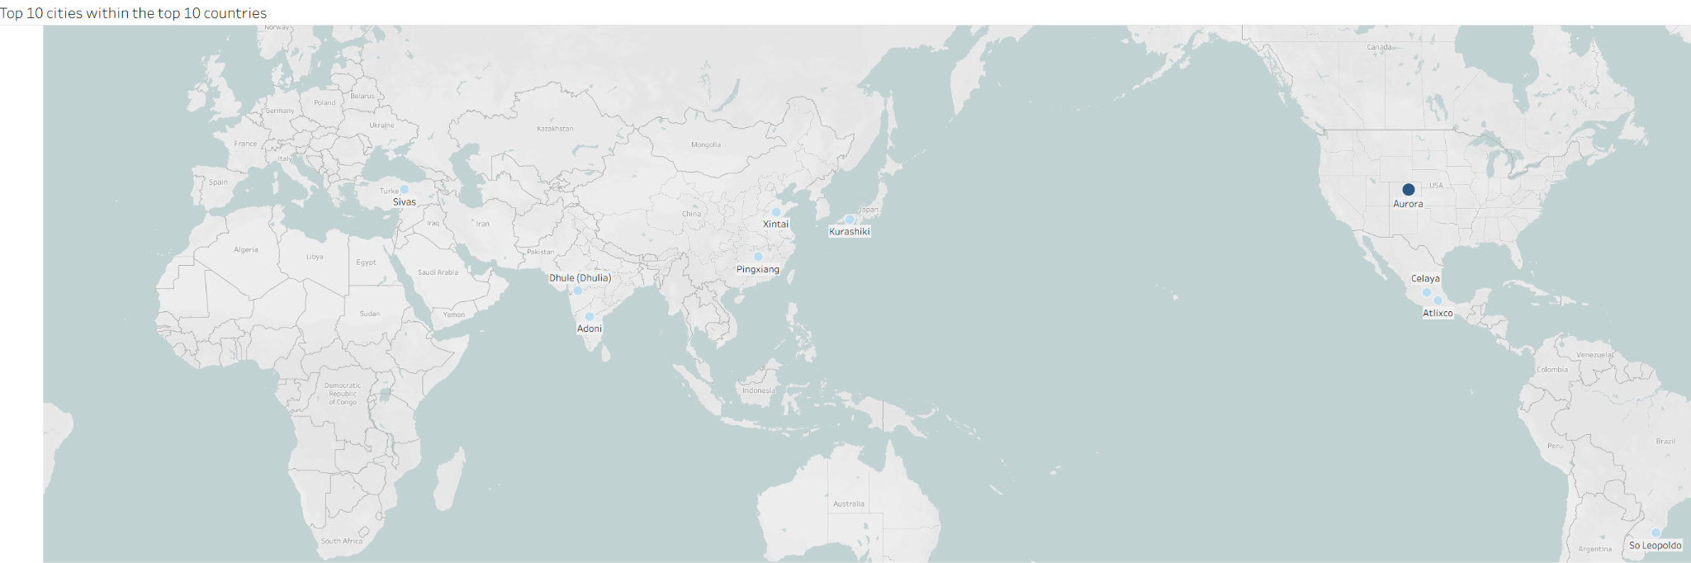
Analysis and Insights
This map visualises the ranked top 10 cities within the previously disclosed top 10 countries.
Highlighting the top 10 cities pinpoints the cities currently driving Rockbuster’s customer engagement, which allows them to plan targeted marketing, partnerships, and service optimization where it matters most.
Confidential

Slide 10
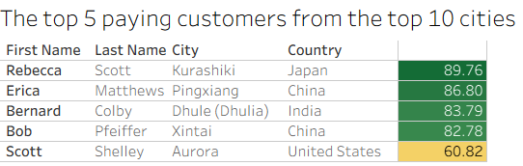
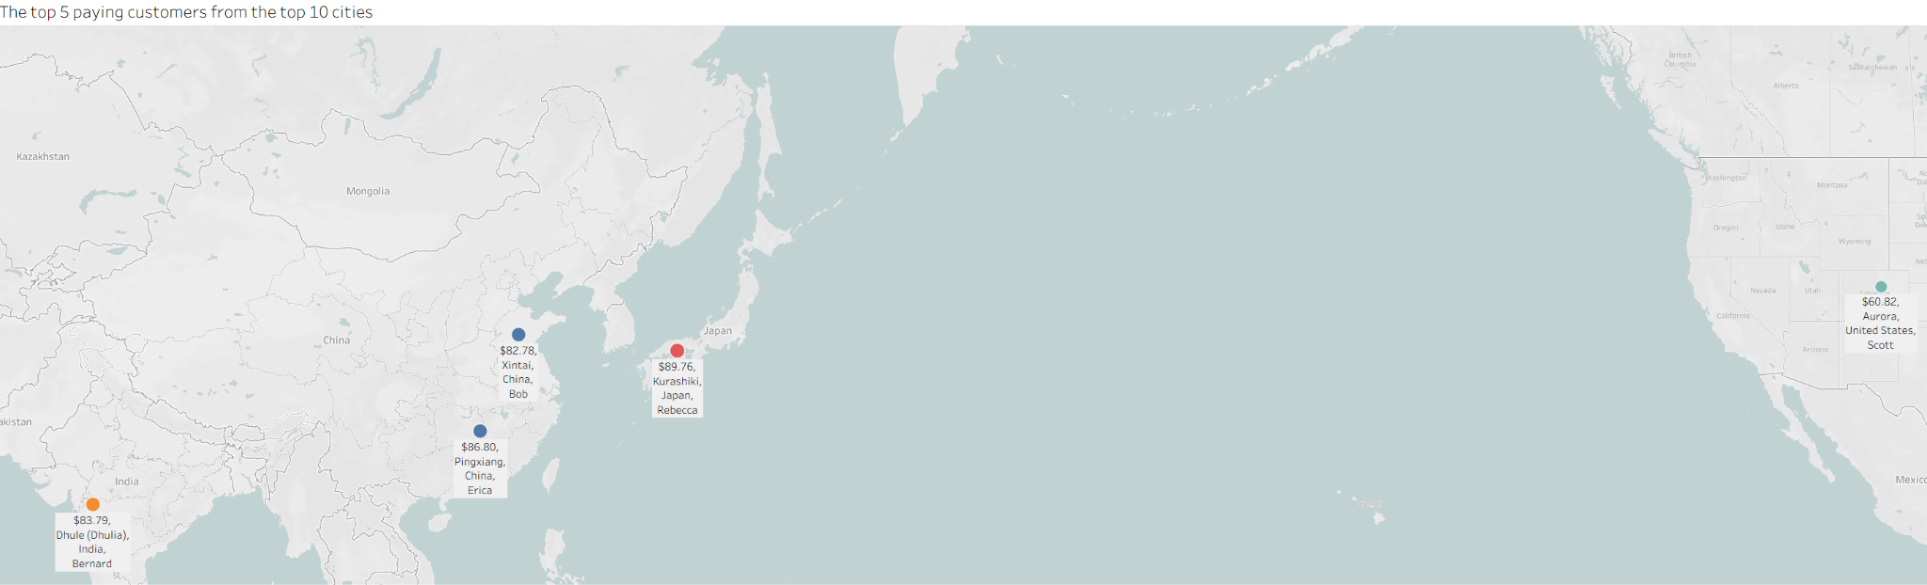
Analysis and Insights
By highlighting the top paying customers across the key markets, we can identify patterns in different regions, which can enable Rockbuster to offer tailored deals that could drive retention and revenue.
This visualisation and table helps to focus actions and strategy on the most profitable customer segments.
Confidential

Slide 11
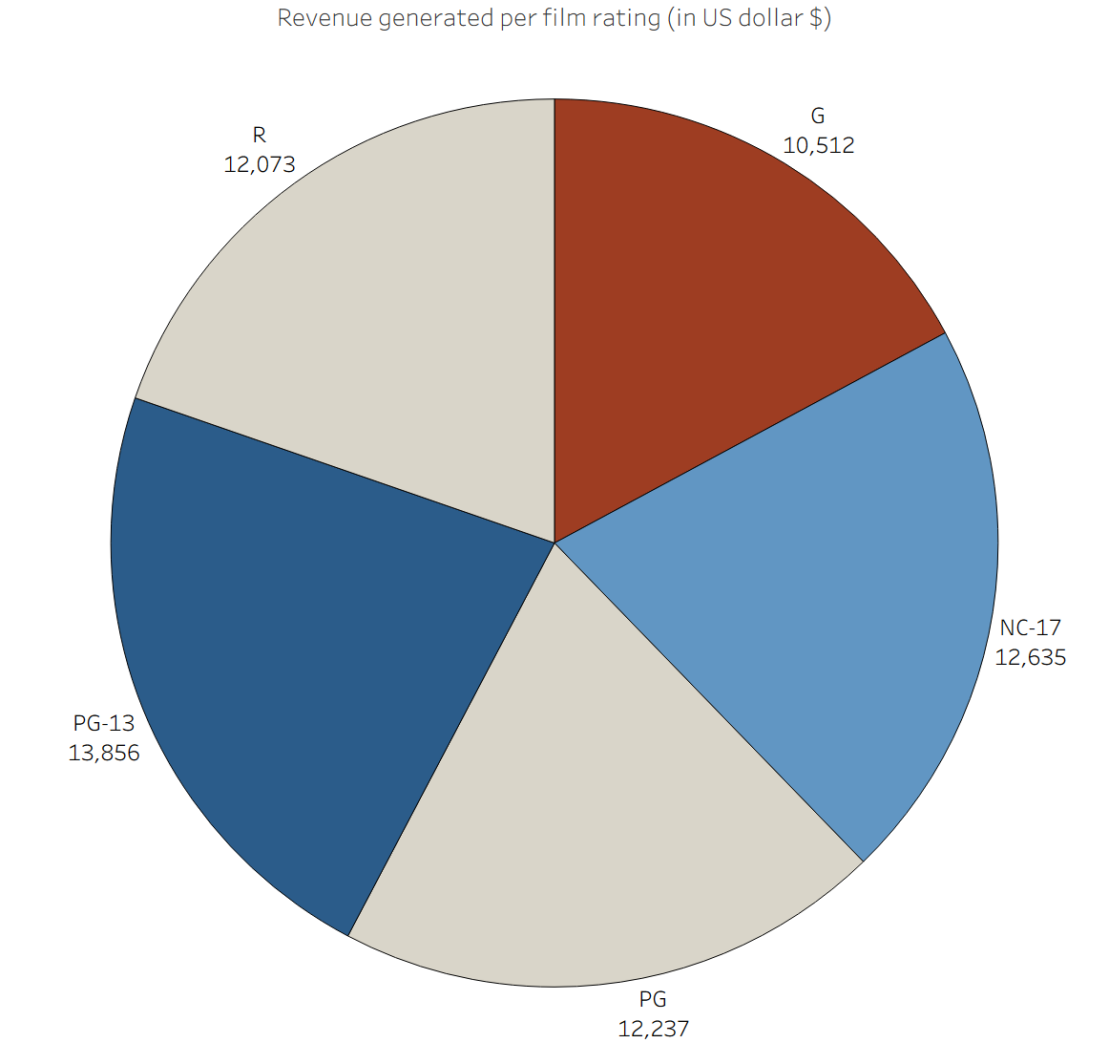
Analysis and Insights
The pie chart demonstrates the film ratings which generated the most revenue for the company, in this case, PG-13 with $13,856 generated.
Confidential

Slide 12
Conclusion -
Key Takeaways
Rental duration + rate
Customer bases
The average rental duration of 5 days coupled with the average film length of 115 minutes indicates that standard-length films are the most popular still.
Customer base is geographically diverse. The Rockbuster business model has been successful across different markets, globally. This bodes well for future plans, based on the strong foundations.
Revenue is strong and consistent across all rating levels. This shows the library that Rockbuster is offering appeals to a wide variety of customers.
Revenue
Confidential

Slide 13
Recommendations
Implement loyalty programs
Work on loyalty programs and offers to reward high-value customers, but to also grow this customer segment.
Further growth in established/growing markets
Tailor marketing and advertising strategies to expand the established markets (USA, Japan, China), but with localised and focused campaigns in the growing markets also (Mexico, Brazil)
Rental duration windows
We see that the average rental duration is at 5 days, which is a good idea for standard films (average rental length is 115 mins.) Thinking about different rental plans (3 days or 1 week perhaps) could be the type of flexibility that appeals to new and existing customers.
Confidential

Slide 14
Recommendations per region
Europe
Our data tells us that Europe provides consistently good returns, but is also an area where growth is possible. Allocation of extra resources to win further customers is recommended.
USA/Canada
A strong and established market that needs to be maintained. The strongest and most consistent region that could potentially be used to trial new titles, genres and ideas (like the different rental windows I previously mentioned)
Asia/APAC
A mix of strong markets with India and China and expanding markets like Japan and Philippines. There is huge potential for growth in this area through localised campaigns that really cater to the local audience.
Confidential

Slide 15
Tableau links:
Top 10 Countries of Operation:
https://public.tableau.com/app/profile/jason.roche1622/viz/Task3_101-JasonRoche/Sheet1?publish=yes
Top 10 Cities within the Top 10 Countries: https://public.tableau.com/app/profile/jason.roche1622/viz/Task3_102-JasonRoche/Sheet1?publish=yes
Top 5 Paying Customers from the Top 10 Cities: https://public.tableau.com/app/profile/jason.roche1622/viz/3_103Task-JasonRoche/Sheet1?publish=yes
Revenue generated per film rating:
https://public.tableau.com/app/profile/jason.roche1622/viz/Task3_104-JasonRoche/Sheet1?publish=yes
Confidential

Slide 16
Thank you!
Contact our team
Jason@careerfoundrydata.com
Confidential

